Slide 1
Function Templates

Slide 2
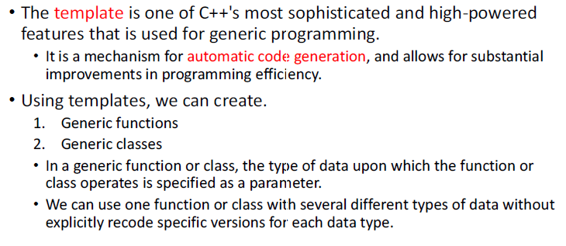
Templates in C++

Slide 3
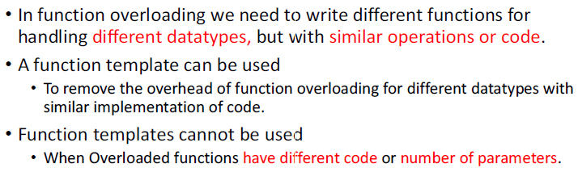
Function Templates in C++ and function overloading

Slide 4
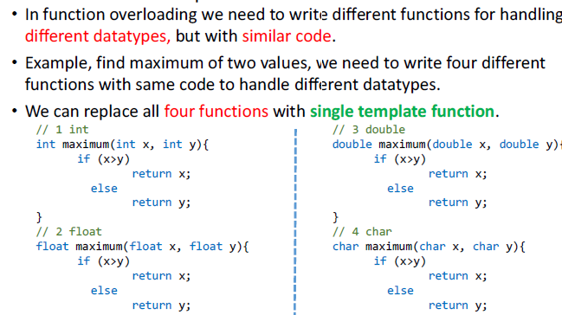
Function Templates in C++ and function overloading

Slide 5
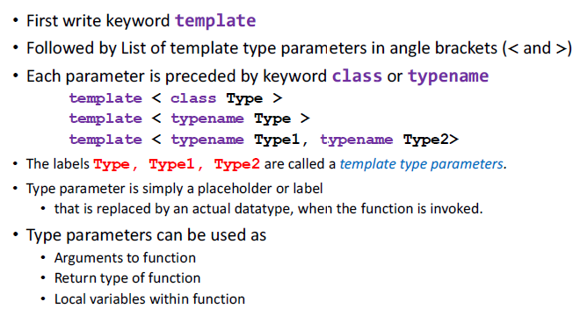
Function Templates in C++: Template header

Slide 6
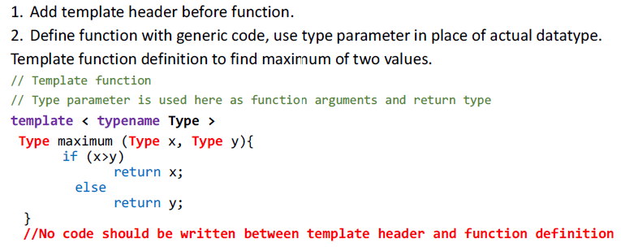
Function Templates in C++: Template header

Slide 7
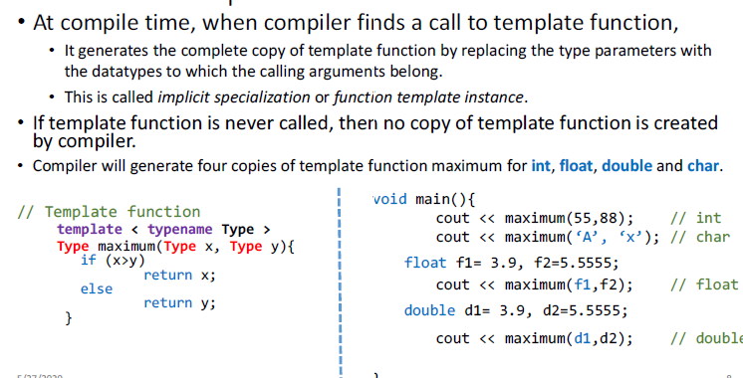
Function Templates in C++: call

Slide 8
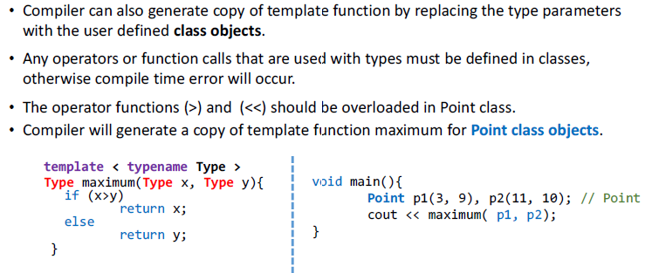
Function Templates in C++: call with class objects

Slide 9
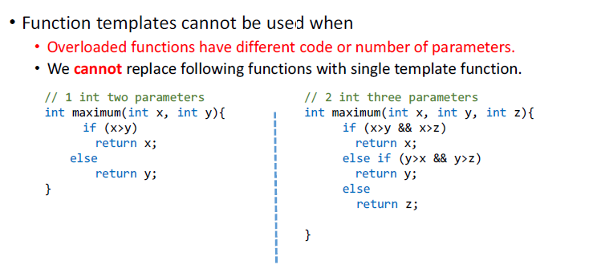
Function Templates in C++

Slide 10
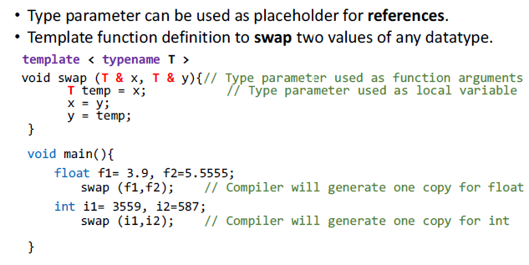
Function Templates in C++

Slide 11
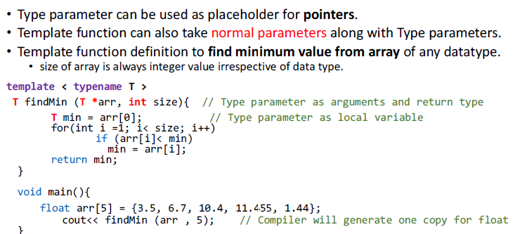
Function Templates in C++

Slide 12
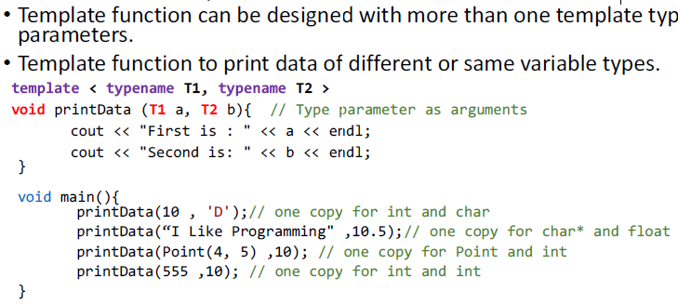
Function Templates in C++:More than one Generic Types

Slide 13
Function Templates in C++:More than one Generic Types
Write a template function that returns the average of all the elements of an array. The arguments to the function should be the array name and the size of the array (type int). In main(), exercise the function with arrays of type int, long, double, and char.

Slide 14
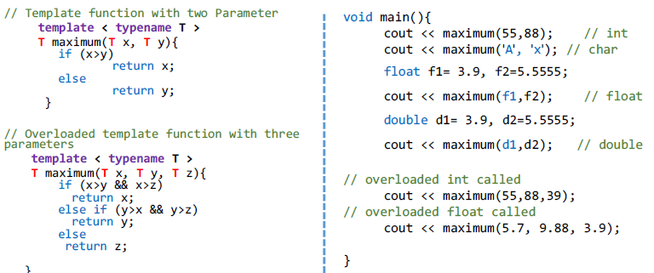
Function Templates overloading

Slide 15
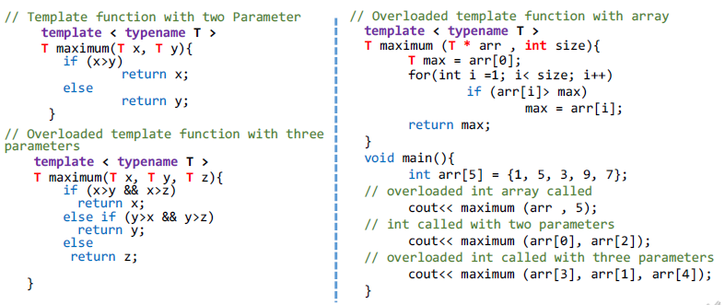
Function Templates overloading

Slide 16
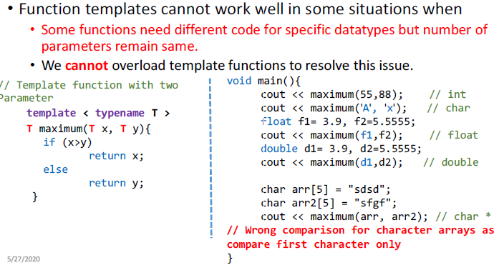
Function Templates

Slide 17
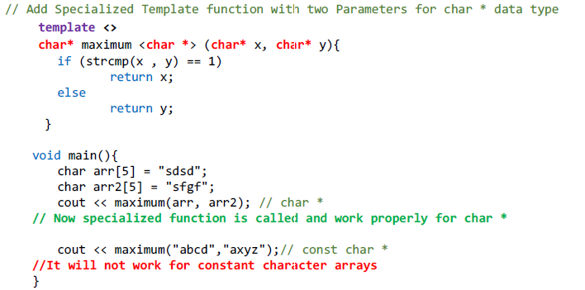
Function Templates specialization

Slide 18
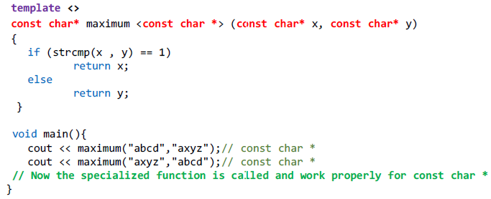
Function Templates specialization

